Slide 1
Introduction Operating System Concepts System Calls

Slide 2
Review
OS
Is a system software
Locates in kernel mode
Efficiently controls and coordinates user interaction with hardware resource
Terminology
Kernel mode, User mode
Latency time
Switch user mode ↔ kernel mode

Slide 3
Objectives
Operating System Concepts
Processes
Address Spaces
Files
I/O
Protection
The Shell
Ontogeny Recapitulates Phylogeny
(evolution of computer hardware and software)
System Calls

Slide 4
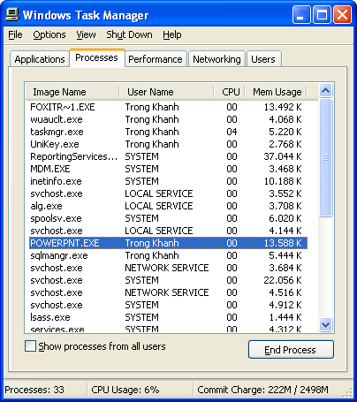
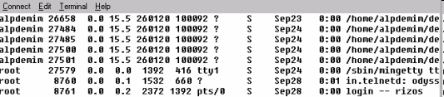
Operating System Concepts Processes
Context
What is the process? When does the process appear on?
Many processes exist at any time, do the many programs run in parallel? How does the OS manage them?

Slide 5
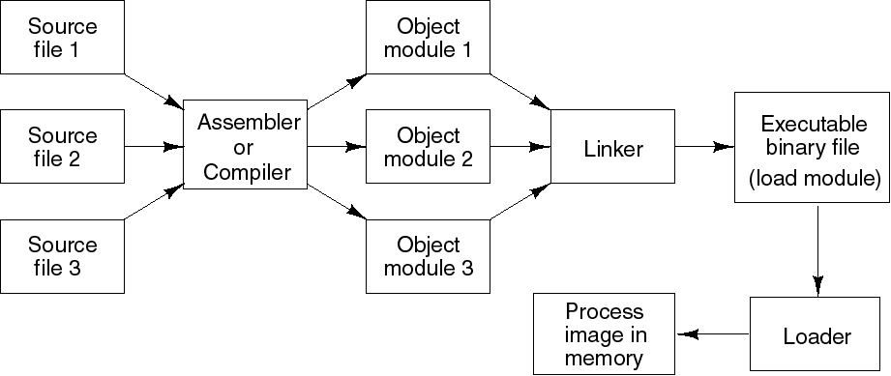
Operating System Concepts Processes
A program in execution
A program loaded into memory and executing
Associated with each process is set of resources such as executable code, data, stack, CPU registers value, PC, and other information needing to run a program
Associated with each process is its address space (i.e., all memory locations that the process can read and write)

Slide 6
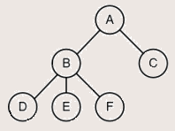
Operating System Concepts Processes
Process table (array or linked list) stores all the information of processes
A system consists of a collection of processes (many programs)
Supporting OS switches the CPU between processes
A process hierarchy (tree)
A process (parent) can create another processes, then the child process can create many processes, forming a process hierarchy
A process has only one parent, but it has zero, one, or more children
A particular OS will implement this concept in different ways
Tanenbaum, Fig. 1-13.

Slide 7
Operating System Concepts Address Spaces
Problems
OS allows multiple programs loaded into memory (multiple processes) at the same time (However, the memory is limited)
→ The system may even pause a running program, swap it out of memory, and later swap it back to somewhere different
→ This can require the developer determined the absolute address of program located in the memory at the time (impossible)
Solutions: Address space is used
Make the different programs think they have the hardware on their own (protection mechanism)
An address spaces is the abstraction that is referenced to the set of addresses for a process
Address space is a list of memory locations (set of addresses) from 0 to some maximum, which the process can read and write (the developer can be flexible in coding)
The address space is decoupled from the physical memory (larger or smaller)

Slide 8
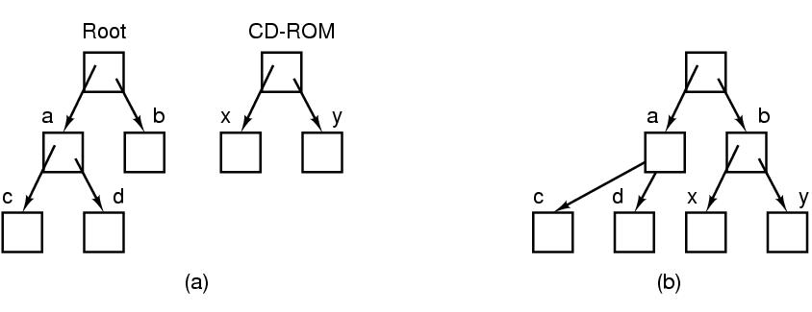
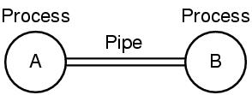
Operating System Concepts Files
Definition
A collection of related information
An abstraction of data stored on HDD
Correlated info
path name, root directory, file descriptor (Windows)
Mounted file system
A pipe (UNIX)
A mechanism for passing data among processes
Is a sort of pseudofile that can be used connect 2 processes
Allows a child process to inherit a communication channel from its parent; data written to one end of the pipe can be read at the other
Tanenbaum, Fig. 1-15 & 16.

Slide 9
Operating System Concepts Files
Definition (cont)
Special file
Make I/O devices look like file that are used for reading or writing
Associates with device driver
2 kinds: block special files and character special files
Block special file
Ex: disks
Is one consisting of sequence of numbered blocks
Each block can be individually (randomly) addressed and accessed
Character special file
Ex: printer, modem, mice, …
Is used for devices that input or output a character stream
Cannot be randomly accessed (not block and not addressed)
Directory
Provide a place to keep files or a way of grouping files together

Slide 10
Operating System Concepts Input/Output
All computers have physical devices for acquiring input and producing output.
Some of them can be shared devices
Others can be dedicated devices
→ How does OS manage/ manipulate I/O (physical) devices?
Every OS has an I/O subsystem for managing its I/O devices
Some of I/O software is device independent
Others are specific to particular I/O devices using device driver
→ OS uses the I/O software based on I/O hardware

Slide 11
Operating System Concepts Protection
Is a mechanism for controlling the access programs, processes, or users of the resources defined by OS
Involves ensuring that all access to system resources is controlled
Protect the code of OS against the processes
Protect one process against other processes
Can improve reliability be detecting latent errors at the interface between component subsystems
OS manage the system security such as
Authentication, protecting the system from unwanted intruders
Give attributes of file to protect the file accession

Slide 12
Operating System Concepts The Shell
Is a piece of software that essentially provides a kind of interface for end-users
Is the UNIX command interpreter (or command-line interface) (Ex: terminal), or GUI (Ex: Gnome, KDE)
Although it is not part of the OS, it makes heavy use of many OS features
Many shells exist such as sh – Shell, csh – C Shell, ksh – Korn Shell, and bash – Bourne Again Shell (default shell in most Linux system)
Functionalities
Is started up (when user logs in) with prompt ($) character
Has the terminal as standard input and output
The shell scripts is a file that contains a list of shell command to be executed in order (same as the bat file in DOS)

Slide 13
Operating System Concepts Ontogeny Recapitulates Phylogeny
Early computers had hardwired instruction sets
The instructions were executed directly by hardware and could not be changed (Not flexible)
Then came microprogramming (faster)
Large Memories
Had just over 128 KB (from 1959 to 1964) using assembly language
Have lots of memory nowadays (up to Gigabytes, Terabytes …)
Protection Hardware
No protection hardware on IBM 7090/7094 so they just ran one program at a time, minicomputer and Intel 8080 – 80286 CPU running multiprogramming
Microcomputer protects hardware and runs ability of multiprogramming at once

Slide 14
Operating System Concepts Ontogeny Recapitulates Phylogeny
Disks
Largely magnetic-tape based (no disks, no file system concepts)
First hard disk (by IBM in 1956) named RAMMAC (4m², store 5 million 7 bit characters, 35.000 $)
CDC 6600 in 1964 (permanent files)
In 1970, the standard disk with 2.5 MB (40cm diameter and 5cm high) had single directory
Floppy disk (512KB, 1.2MB, 1.4 MB …)
Hard disk, Optical, Smart card ….
Virtual Memory
Gave the ability to run programs larger than the machine’s physical memory by moving pieces back and forth between RAM and disk
Enabled the ability to have a program dynamically link on a library at run time

Slide 15
System Calls
Context
How do the OS work when we call the fopen and fscanf function to read a text file using C code?
Is the fopen or fscanf function as OS command that can access or control the disk?
Where do both of function operate? Kernel mode or user mode?
Event
A process is running in user mode and needs a system service, it has to execute a trap instruction (interrupt) to transfer control to the OS (kernel mode)
The OS figures out what the calling process wants by inspecting the parameter, then it carries out the system call and returns the control to the instruction following the system call

Slide 16
What’s a System call?
In computing, a system call is the programmatic way in which a computer program requests a service from the kernel of the operating system it is executed on.
System calls provide an essential interface between a process and the operating system.

Slide 17
System Calls
The interface between user programs and the OS (hidden to user)
Permit application programs to access protected resources
Making a system call is like making a special of procedure call located in the kernel
Steps in making a system call
Programs put the arguments in registers or on the stack
Then, it issues trap instructions to switch form user mode to kernel mode at the fixed address where the procedure located
The kernel mode dispatches to the correct system call handler
When the system call handler has completed its work, the trap instructions is issued to witch form kernel to user mode
Then, the procedure returns to the user program in the usual way procedure calls return
System calls vs. System Programs
System programs provide a convenient environment for program development and execution (e.g, file manipulation, status, etc…)
System programs define the view of the OS seen by most users
Are simply user interfaces to system call

Slide 18
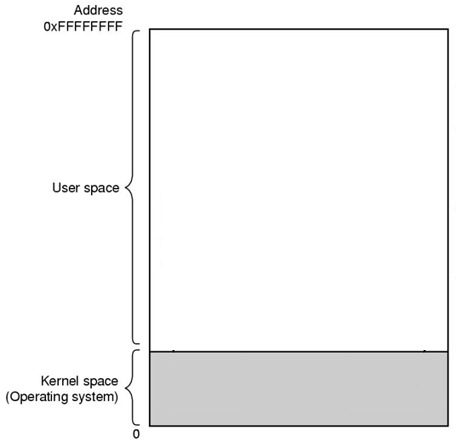
Example
Code Segment
Stack Segment
There are 11 steps executing the system call: read (fd, buffer, nbytes)
Tanenbaum, Fig. 1-17.

Slide 19
Example
Code Segment
Stack Segment
There are 11 steps executing the system call: read (fd, buffer, nbytes)
Tanenbaum, Fig. 1-17.

Slide 20

Example
Code Segment
Stack Segment
There are 11 steps executing the system call: read (fd, buffer, nbytes)
Tanenbaum, Fig. 1-17.

Slide 21

Example
Code Segment
Stack Segment
There are 11 steps executing the system call: read (fd, buffer, nbytes)
Tanenbaum, Fig. 1-17.

Slide 22
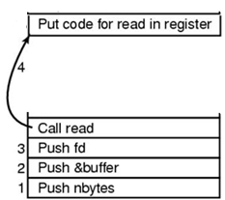
Example
Code Segment
Stack Segment
There are 11 steps executing the system call: read (fd, buffer, nbytes)
Tanenbaum, Fig. 1-17.

Slide 23

Example
Code Segment
5
Stack Segment
6
There are 11 steps executing the system call: read (fd, buffer, nbytes)
Tanenbaum, Fig. 1-17.

Slide 24
Example
Code Segment
5
Stack Segment
9
6
There are 11 steps executing the system call: read (fd, buffer, nbytes)
Tanenbaum, Fig. 1-17.

Slide 25
Example
Code Segment
5
10
Stack Segment
9
6
There are 11 steps executing the system call: read (fd, buffer, nbytes)
Tanenbaum, Fig. 1-17.

Slide 26
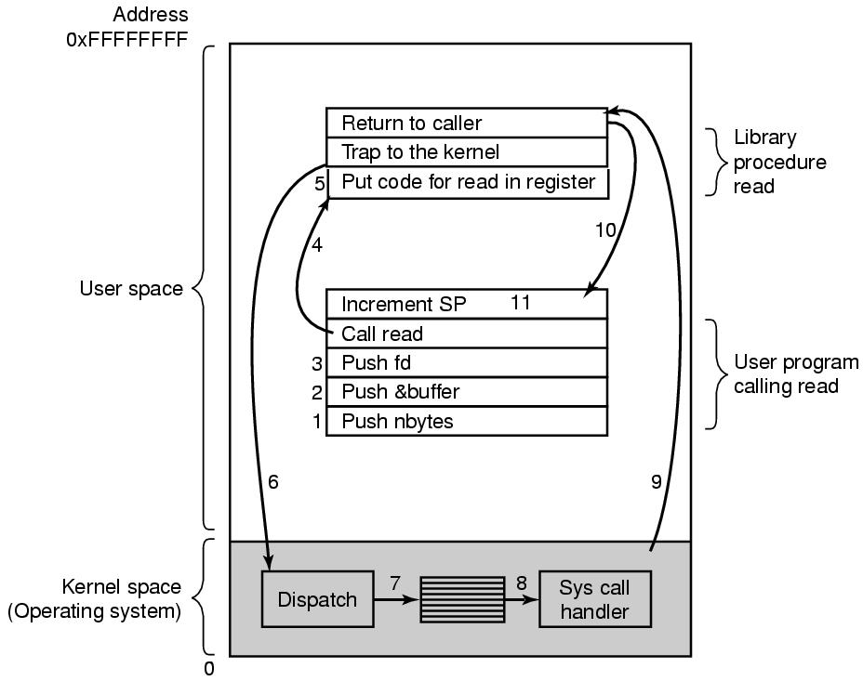
Example
Code Segment
Stack Segment
There are 11 steps executing the system call: read (fd, buffer, nbytes)
Tanenbaum, Fig. 1-17.

Slide 27
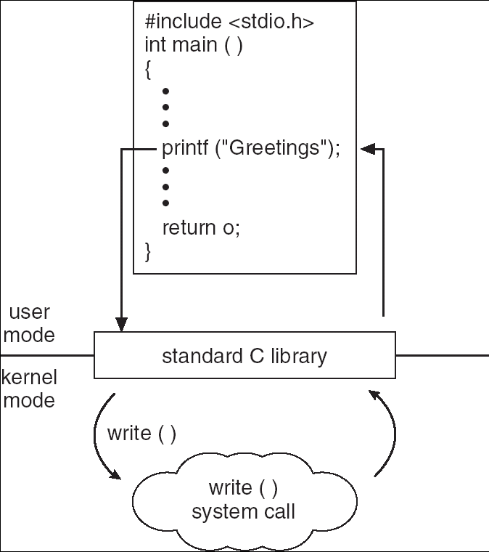
Example

Slide 28
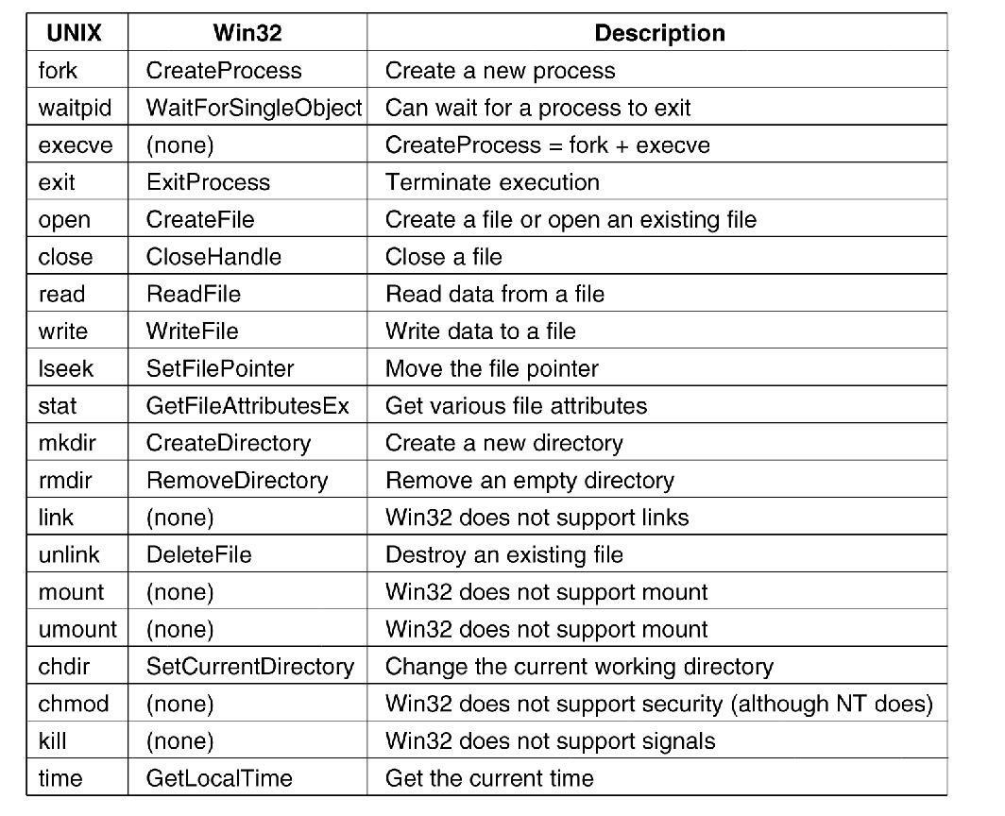
System Calls (cont)
System calls for
Process management: fork(), exec(), wait(), exit() …
File management: open(), close(), read(), write(), lseek(), stat() …
Directory and File system management: mkdir(), mount(), link(), chown() …
Miscellaneous: chdir(), chmod(), kill(), time()
Windows Win32 API
Tanenbaum, Fig. 1-23.

Slide 29
Summary
Operating System Concepts
System Calls
Q&A

Slide 30
Next Lecture
OS Structures

